Slide 1
I210 – Introduction to Programming with Python
Lecture 12

Slide 2

Today
Reading from Files
Writing from Files
OS Module

Slide 3
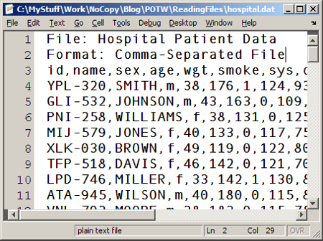
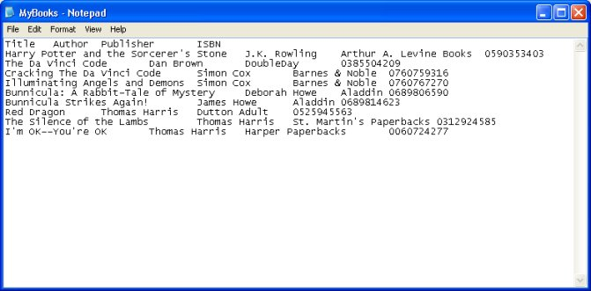
Working with Files
To pull in data from other sources, we need to be able to read from files.
To save data between program executions, we need to be able to write to files.

Slide 4

Working with Files
Opening a file:
text_file = open("test.txt", "r")
"r" is the access mode. In this case, it’s read.
This creates a file object called text_file.
Closing a file: Always close open files!
text_file.close()
test.txt

Slide 5
Reading from Files
We can read an entire file at once:
# .read() returns the entire file as a string
file_contents = text_file.read()
print(file_contents)
If we want to be able to use string methods, this is our best choice for reading a file!

Slide 6
Filename Extensions
It’s important to know the exact name of the file we want to interact with!
text_file = open("test.txt", "r") vs
text_file = open("test.txt.txt", "r")
OS file systems don't always show filename extensions, which sometimes causes confusion:
what if a file is named myprogram.py but you only see myprogram ?
what if a file shows up as myfile.py but it's really named myfile.py.txt ?

Slide 7
Filename Extensions
Make sure that your system shows all filename extensions!
Instructions for Windows:
http://www.file-extensions.org/article/show-and-hide-file-extensions-in-windows-10
http://www.eightforums.com/tutorials/30434-file-name-extensions-hide-show-windows-8-a.html
http://windows.microsoft.com/en-us/windows/show-hide-file-name-extensions
Instructions for Mac OS X:
http://osxdaily.com/2012/01/13/show-filename-extensions-in-mac-os-x/
http://support.apple.com/kb/PH10845

Slide 8
Reading from Files
A note about reading from files:
If you hit the Enter key in a text file, it adds a "\n" that’s invisible.
If the file contains a blank line, Python will still read the "\n”.
When you print this out, you’ll just see a blank line.

Slide 9
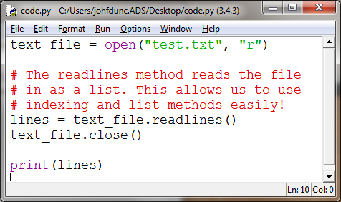
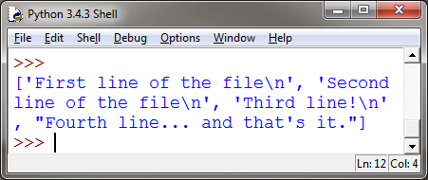
Reading from Files
You can also read lines into a list: (our default if you want to use list methods!)

Slide 10
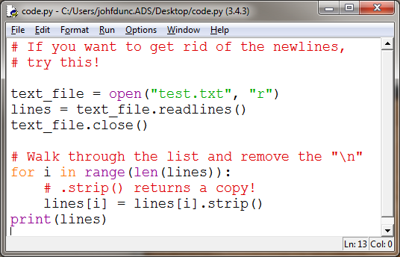
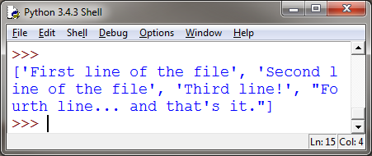
Line Cleaning
HINT: If your lines are numbers, and you want the \n removed, you can just int() or float() them!

Slide 11
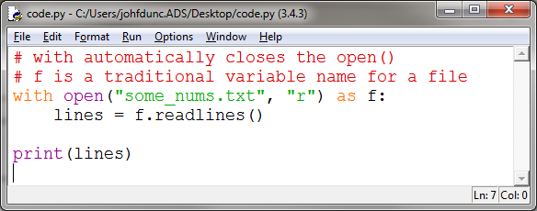
Files
This is an alternate way to interact with a file:
The with keyword creates a code block. After that code block finishes, the file is automatically closed!

Slide 12
Writing to a File
text_file = open("write_it.txt", "w")
“w” is write mode. This allows us to create files!
The file write_it.txt springs into existence as an empty text file.
If the file write_it.txt had already existed, it would have been replaced with a brand‐new, empty file and all of its original contents would have been erased.

Slide 13
Writing to a File
Writing to a file is very similar to reading from one.
This creates a file called “write_it.txt” with three lines:
text_file = open("write_it.txt", "w")
text_file.write("Line 1\n")
text_file.write("This is line 2\n")
text_file.write("That makes this line 3\n")

Slide 14
Writing to a File
Nothing is actually written until you close the file.
Make sure you close the file after writing to it!!
text_file = open("write_it.txt", "w")
text_file.write("Line 1\n")
text_file.write("This is line 2\n")
text_file.write("That makes this line 3\n")
text_file.close()

Slide 15
Writing to a File
We can write from a list to a file:
lines = ["Line 1\n", "This is line 2\n", "That makes this line 3\n"]
text_file.writelines(lines)
Line 1
This is line 2
That makes this line 3
Lists are a great intermediary data structure for files!

Slide 16
File Access Modes
Mode | Description
"r" | Read from a text file. If the file doesn’t exist, ERROR.
"w" | Write to a text file. If the file exists, it is overwritten. If it doesn’t exist, it is created.
"a" | Append to a text file. If the file exists, new data is added onto the end. If it doesn’t exist, it is created.
"r+" | Read and write to a file. If the file doesn’t exist, ERROR.
"w+" | Read and write to a file. If the file exists, it is overwritten. If it doesn’t exist, it is created.
"a+" | Append and read to a file. If the file exists, new data is added onto the end. If it doesn’t exist, it is created.

Slide 17
File Locations
If you just specify the name of the file, Python looks for it in the same directory as the .py file you’re running.
You can also specify the path manually:
Windows:
text_file = open("C:/Users/J/Desktop/test.txt", "r")
Mac OS X:
text_file = open("/Users/J/Desktop/test.txt", "r")

Slide 18
File Locations
You can use this to get the path to the directory where your .py file is running:
import os
path = os.getcwd() #get current working directory
print(path)
>>>
C:\Users\johfdunc.ADS\Desktop

Slide 19
OS Module (Used a lot in I211)
When working with files, the os module is very useful. Here, we list the contents of the current directory:
import os
#getcwd comes from ‘GET Current Working Directory’
contents = os.listdir(os.getcwd())
print(contents)
>>>
['code.py', 'Collegium Work', 'desktop.ini', 'Fall 14 Schedule.txt', 'I210 - Syllabus.docx', 'I211 - Syllabus.docx', 'notes.txt', 'Other', 'pickles1.dat', 'Spring 15 Schedule.txt', 'Teaching', 'tools.py']
(The items in blue are directories – they don’t have an extension!)

Slide 20
Questions?

